Slide 1
JACL
Your Anime Streaming Compass

Slide 2
Problem
• Finding where to watch content is fragmented
• Users jump between multiple platforms
• Information is often cluttered or incomplete
When users want to find shows or anime, they usually have to check multiple sites. Our goal was to reduce that friction.

Slide 3
Solution
• One centralized discovery platform
• Clean and intuitive user interface
• Fast access to relevant media information
We built a website that pulls everything together and presents it in a clean, easy-to-use way.

Slide 4


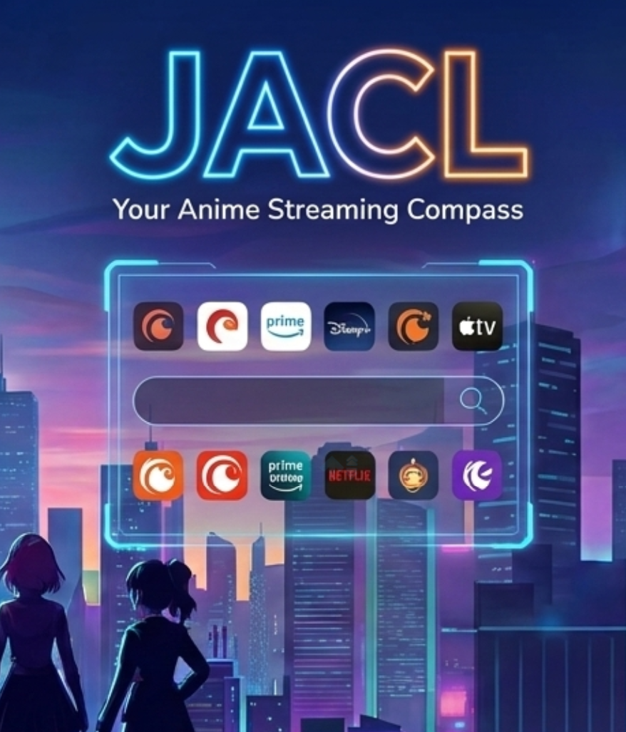
User Journey
• User lands on the homepage
• Searches for a movie, show, or anime

Slide 5
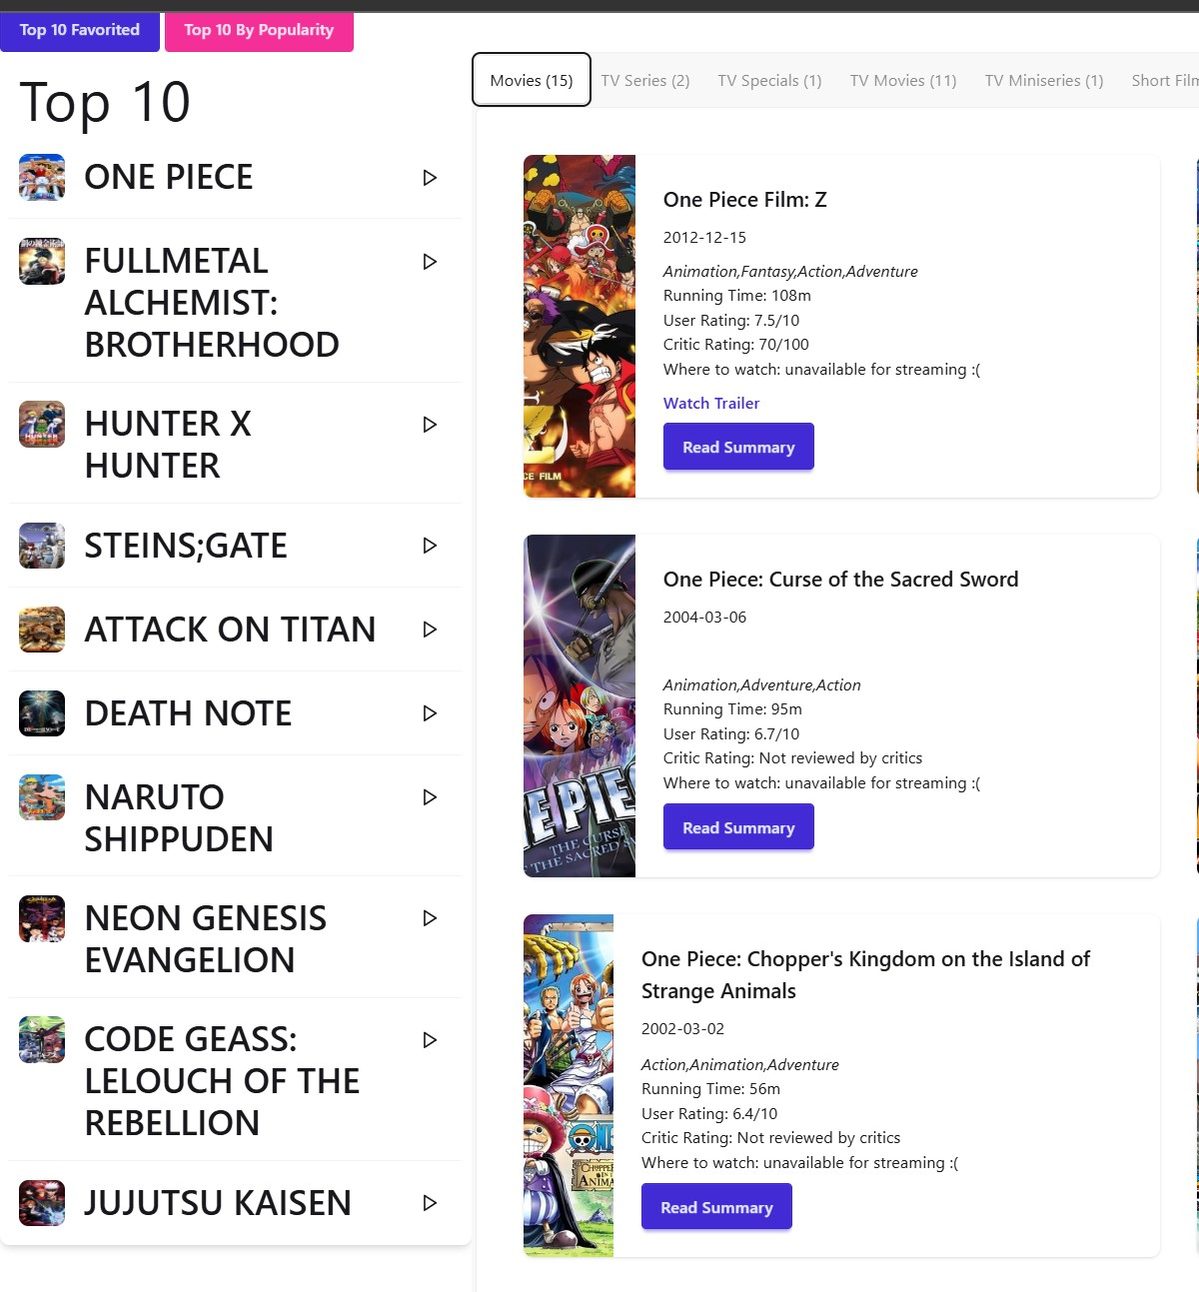
• Results are displayed dynamically
• Filters help narrow down choices
Once results load, users can filter the data to find exactly what they’re looking for.

Slide 6
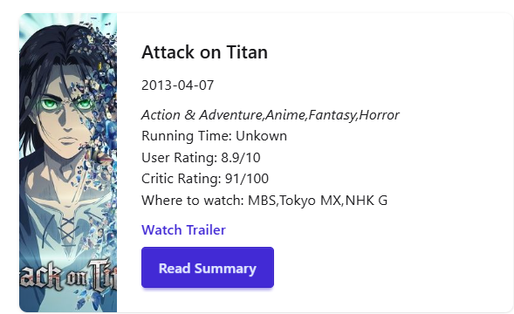
• User selects an item
• Detailed information is displayed
Clicking an item brings up detailed information pulled directly from our APIs.

Slide 7
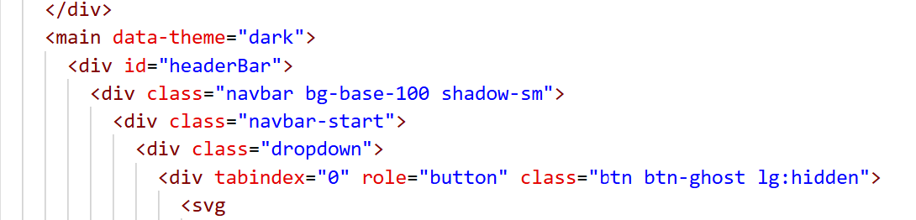
UI Design with DaisyUI
• Used DaisyUI for consistent styling
• Reusable components across the app
• Faster development with prebuilt styles

Slide 8
API Integration
• Watchmode API for streaming availability
• Jikan API for anime data
• Fetch requests used to retrieve live data

Slide 9
Data Filtering & Organization
• Large datasets filtered for clarity
• Results organized for usability
• Improved overall user experience

Slide 10
Conclusion & Next Steps
• Combined UI, APIs, and data logic
• Strong team collaboration
• Future features and refinements possible

